Slide 1


Slide 2
A web application is a dynamic extension of a web or application server. There are two types of web applications:
Presentation-oriented: A presentation- oriented web application generates interactive web pages containing various types of markup language (HTML, XML, and so on) and dynamic content in response to requests.
Service-oriented: A service-oriented web application implements the endpoint of a web service. Presentation-oriented applications are often clients of service-oriented web applications.

Slide 3
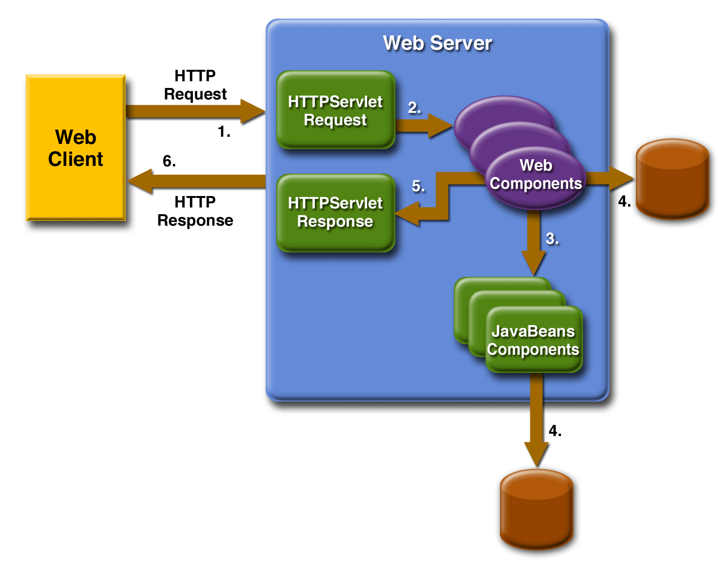
In the Java 2 platform, web components provide the dynamic extension capabilities for a web server. Web components are either Java servlets, JSP pages, or web service endpoints. The interaction between a web client and a web application is illustrated in Figure:

Slide 4

A servlet is a Java programming language class that is used to extend the capabilities of servers that host applications access via a request- response programming model.
Used to implement a service easily and efficiently.
  Easily: programmer may take advantage of support provided by Java Web Server:
    parsing HTTP requests
    handling connections to Web clients.
  Efficiently, run as separate light weight threads of the Java Server process rather than separate heavy weight processes
    load and execute much faster than CGI programs.

Slide 5
Provides an extensive infrastructure for automatically parsing and decoding HTML form data, reading and setting HTTP headers, handling cookies, tracking sessions and other utilities.
    No need to learn new programming languages if you are familiar with Java already.
Servlets are protocol- and platform-independent server-side components, written in Java, to dynamically extend Java-enabled servers.
  run inside servers, don’t need a GUI.
  downloaded on demand to system that requests them.

Slide 6

Initialization
  the servlet engine loads the servlet’s *.class file in the JVM memory space and initializes any objects
Execution
  when a servlet request is made, provide the service
    a ServletRequest object is sent with all information about the request
    a ServletResponse object is used to return the response
Destruction
  the servlet cleans up allocated resources and shuts down

Slide 7

servlet
GenericServlet
HttpServlet
init(ServletConfig);
doGet(HttpServletRequest,
HttpServletResponse);
service(ServletRequest,
ServletResponse);
doPost(HttpServletRequest,
HttpServletResponse);
…….
destroy();

Slide 8

import java.io.*;
import javax.servlet.*;
public class HelloWorld extends GenericServlet
{
public void service(ServletRequest request, ServletResponse response) throws IOException, ServletException
{
response.setContentType("text/html");
PrintWriter out = response.getWriter();
out.println(“<B> Hello!”);
out.close();
}
}

Slide 9
import java.io.*;
import javax.servlet.*;
import javax.servlet.http.*;
public class HelloWorld extends HttpServlet {
public void doGet(HttpServletRequest request,
HttpServletResponse response)
throws IOException, ServletException
{
response.setContentType("text/html");
PrintWriter out = response.getWriter();
out.println("<html>");
out.println("<body>");
out.println("<head>");
out.println("<title>Hello World!</title>");
out.println("</head>");
out.println("<body>");
out.println("<h1>Hello , This is Servlet</h1>");
out.println("</body>");
out.println("</html>");
out.close();
}
}

Slide 10


Slide 11


